Slide 1
CEIS 114 Module 2
Project Plan for IoT Traffic Controller

Slide 2
Rubric – Due at the end of Week 2
Activity | Requirement(s) | Points
Inventory of parts | Picture of required inventory of components | 10
ESP32 mounted and powered ON | Picture | 5
Installation of Arduino IDE | Screenshot of COM port selected | 5
WiFi Scan | Screenshot of Serial Monitor | 5

Slide 3
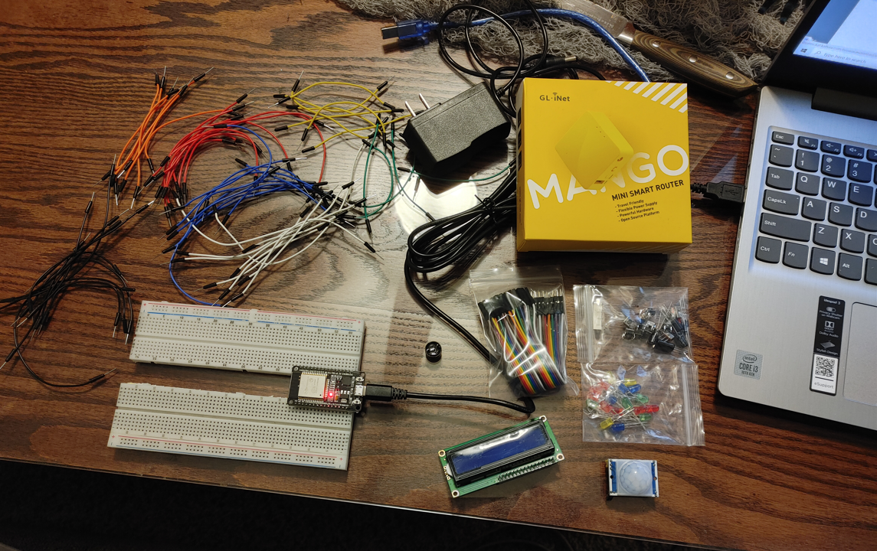
Inventory (Picture)
ESP 32 Board
Colored LEDs: Red, Yellow, Green, and Blue
220 Ohm Resistors (optional)
Wires
Breadboard(s)
LCD Unit with I2C Adapter
Active Buzzer
Mini Router
Push Button(s)
PIR Motion Sensor

Slide 4
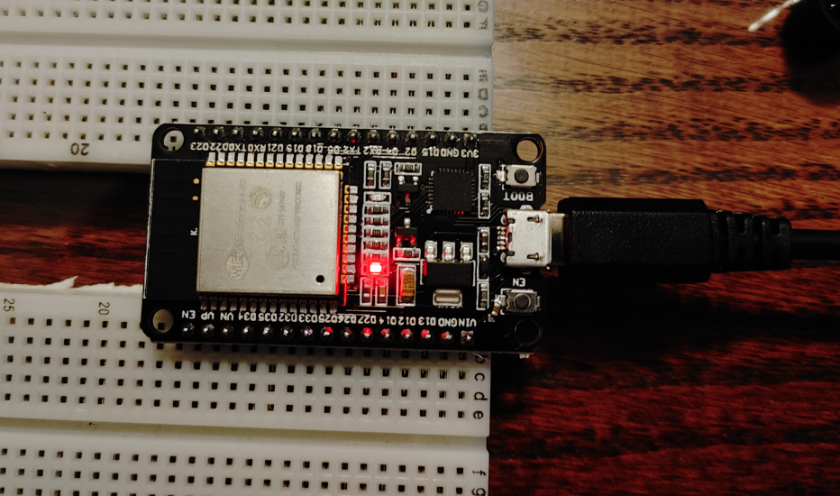
ESP32 (Picture)
Microcontroller mounted and powered ON

Slide 5
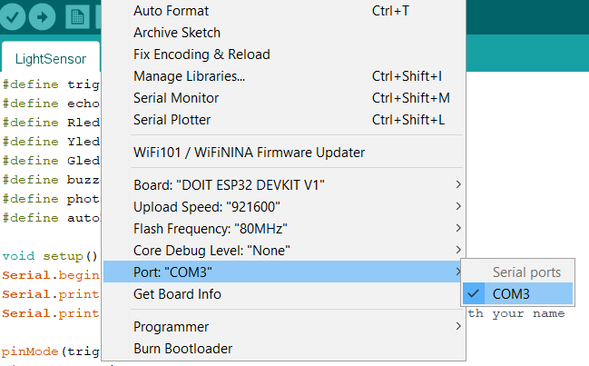
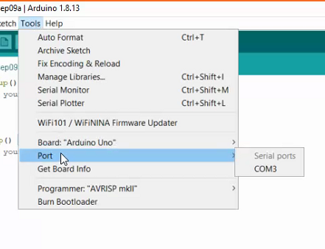
Installation of Arduino IDE
Screenshot of Arduino IDE with Port selected from Tools menu.
Example

Slide 6
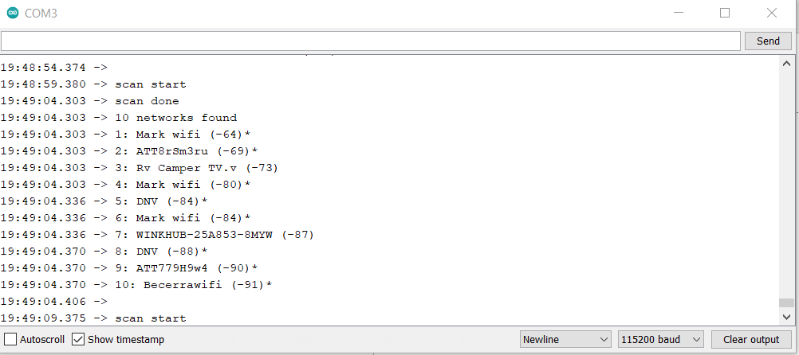
ESP32 WiFi Scan
Screenshot of Serial Monitor in Arduino IDE showing the available networks

